Slide 1
EMPOWERMENT OF TALENT IN THE OCCUPATIONAL SAFETY AND HEALTH OF THE FOREST PLANTATION AND TIMBER INDUSTRY
Prepared by
DATUK HAJI DAUD AMATZIN FiiPM
Deputy President, IIPM
BRIDGING THE WORLD THROUGH planters
A Professional Body offshoot of

Slide 2
SEKSYEN 24,OSHA 1994 - KEWAJIPAN AM PEKERJA YANG SEDANG BEKERJA
Adalah menjadi kewajipan tiap-tiap pekerja yang sedang bekerja :
Untuk memberikan perhatian yang munasabah bagi keselamatan dan kesihatan dirinya dan orang lain yang mungkin terjejas oleh tindakan atau peninggalannya semasa bekerja ;
Untuk bekerjasama dengan majikannya atau mana-mana orang lain dalam menunaikan apa-apa kewajipan atau kehendak yang di kenakan ke atas majikan atau orang lain itu melalui Akta ini atau mana-mana peraturan yang di buat di bawahnya;
Untuk memakai atau menggunakan pada sepanjang masa apa-apa kelengkapan atau pakaian perlindungan yang di adakan oleh majikan bagi maksud mencegah apa-apa risiko kepada keselamatan dan kesihatannya:
Untuk mematuhi apa-apa arahan atau langkah tentang keselamatan dan kesihatan pekerjaan yang di perkenalkan oleh majikannya atau mana-mana orang lain melalui atau di bawah akta ini atau mana-mana peraturan yang di buat di bawahnya.
BRIDGING THE WORLD THROUGH PLANTATION
A Professional Body offshoot of

Slide 3
SEKSYEN 24 - KEWAJIPAN AM
PEKERJA YANG SEDANG BEKERJA
(2) Seseorang yang melanggar peruntukan seksyen ini adalah melakukan suatu kesalahan dan apabila di sabitkan boleh di denda tidak melebihi satu ribu ringgit atau di penjarakan selama tempoh tidak melebihi tiga bulan atau kedua-duanya.
BRIDGING THE WORLD THROUGH PLANTATION
A Professional Body offshoot of

Slide 4
K.Y.T
KIKEN YO CHI TRAINING
Lets go for Zero accident, Okay !
Pointing and Calling
BRIDGING THE WORLD THROUGH PLANTATION
A Professional Body offshoot of

Slide 5
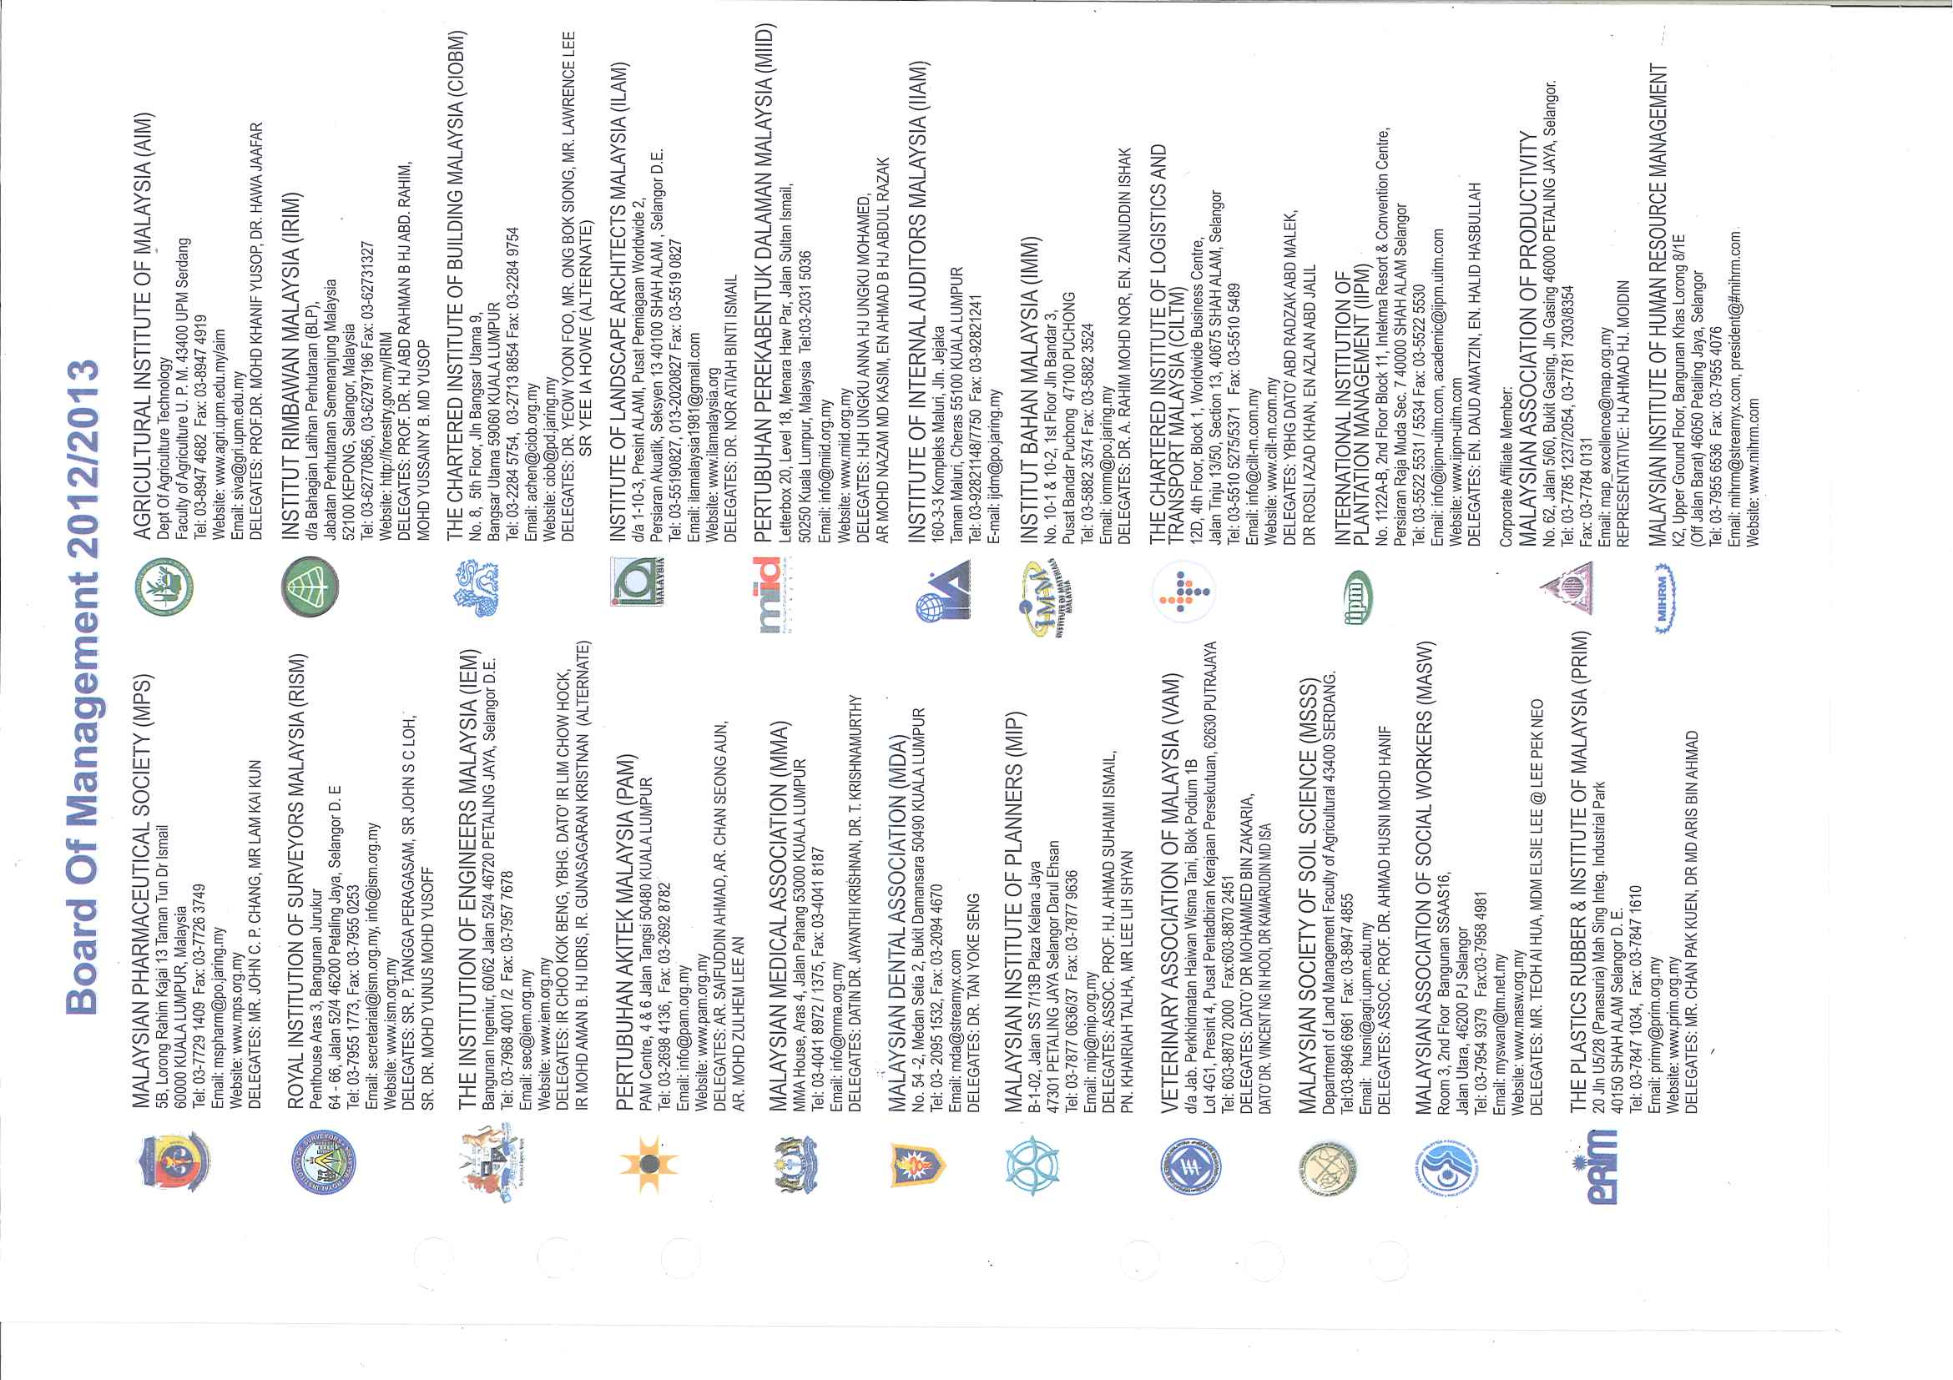
WHAT IS PROFESSIONAL BODY?
The Need for Competency, Integrity, Accountability, Transparency and Good Governance
IIPM is the youngest registered professional body in Malaysia, i.e. no. 19
PROFESSIONAL AND COMPETENCY PROGRAM
A Professional Body offshoot of
BRIDGING THE WORLD THROUGH PLANTATION

Slide 6
WHAT IS PROFESSIONAL BODY?
EXPERIENCES OF OTHER PROFESSIONAL BODIES
STATUTORY PROFESSIONAL BODIES
ROYAL INSTITUTION OF SURVEYORS MALAYSIA (RISM)
INSTITUTE LANDSCAPE ARCHITECTS MALAYSIA (ILAM)
THE INSTITUTION OF ENGINEERS MALAYSIA (IEM)
NON-STATUTORY PROFESSIONAL BODIES
CHARTERED INSTITUTE OF LOGISTICS & TRANSPORT (CILT)
INSTITUTE OF MATERIALS MALAYSIA (IMM)
THE MALAYSIAN INSTITUTE OF CHATERED SECRETARIES AND ADMINISTRATORS (MAICSA)
THE ASSOCIATION OF CHATERED CERTIFIED ACCOUNTANTS (ACCA)
PROFESSIONAL AND COMPETENCY PROGRAM
A Professional Body offshoot of
BRIDGING THE WORLD THROUGH PLANTATION

Slide 7
HOW DOES IIPM WORK?
TO RECOGNIZE PLANTERS AS PROFESSIONALS BY
UPGRADING QUALIFICATIONS – THROGH THE PROFESSIONAL QUALIFICATION EXAMINATION (PQE), WHICH HAS PROPER RECOGNITION FROM MALAYSIAN QUALIFICATION AGENCY (MQA)
UPDATING KNOWLEDGE – INTRODUCING CONTINUOUS PROFESSIONAL DEVELOPMENT PROGRAM (CPD)
RECOGNIZING SKILL & TECHNICAL EXPERTISE FOR A CRITICAL TASKING – SIJIL KEMAHIRAN MALAYSIA (SKM)
ESTABLISHMENT OF PROFESSIONAL MEMBERSHIP GRADE – CERTIFIED PLANTER (CP) FOR PROFESSIONAL PLANTERS.
BRIDGING THE WORLD THROUGH PLANTATION
A Professional Body offshoot of

Slide 8
FOUNDING OF IIPM
Nurturing Professional Planters
THE INTERNATIONAL INSTITUTE OF PLANTATION MANAGEMENT (IIPM) IS A PROFESSIONAL BODY REPRESENTING ALL SECTORS OF THE PLANTATION INDUSTRY. IT WAS FOUNDED IN MAY 2005 AS AN OFFSHOOT OF THE UNIVERSITI TEKNOLOGI MARA (UiTM). REGISTERED UNDER TRUSTEE COMPANY LIMITED BY GUARANTEE.
BRIDGING THE WORLD THROUGH PLANTATION
A Professional Body offshoot of

Slide 9
PURPOSE OF IIPM
THE PURPOSE OF ITS ESTABLISHMENT IS:
TO PROMOTE KNOWLEDGE OF THE SCIENCE AND ART OF PLANTING MANAGEMENT
TO PROVIDE A SOURCE OF AUTHORITATIVE VIEWS FOR COMMUNICATION TO THE GOVERNMENT, INDUSTRY AND COMMUNITY
BRIDGING THE WORLD THROUGH PLANTATION
A Professional Body offshoot of

Slide 10
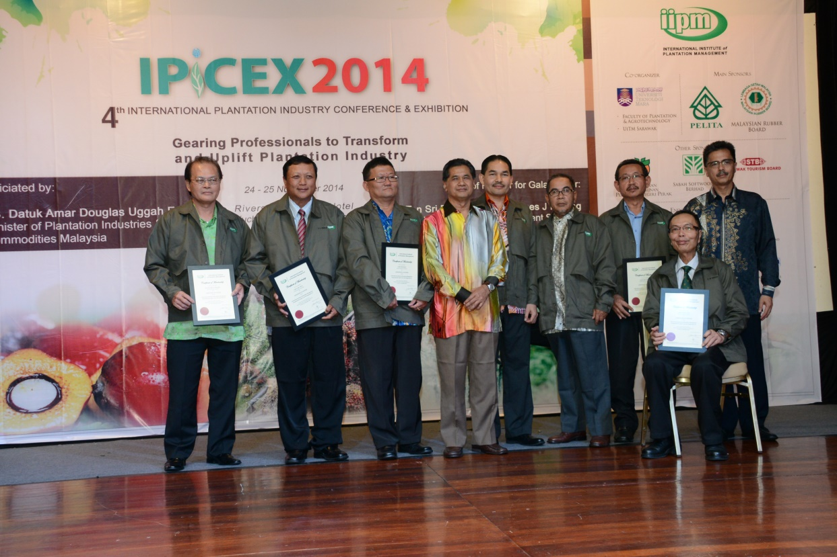
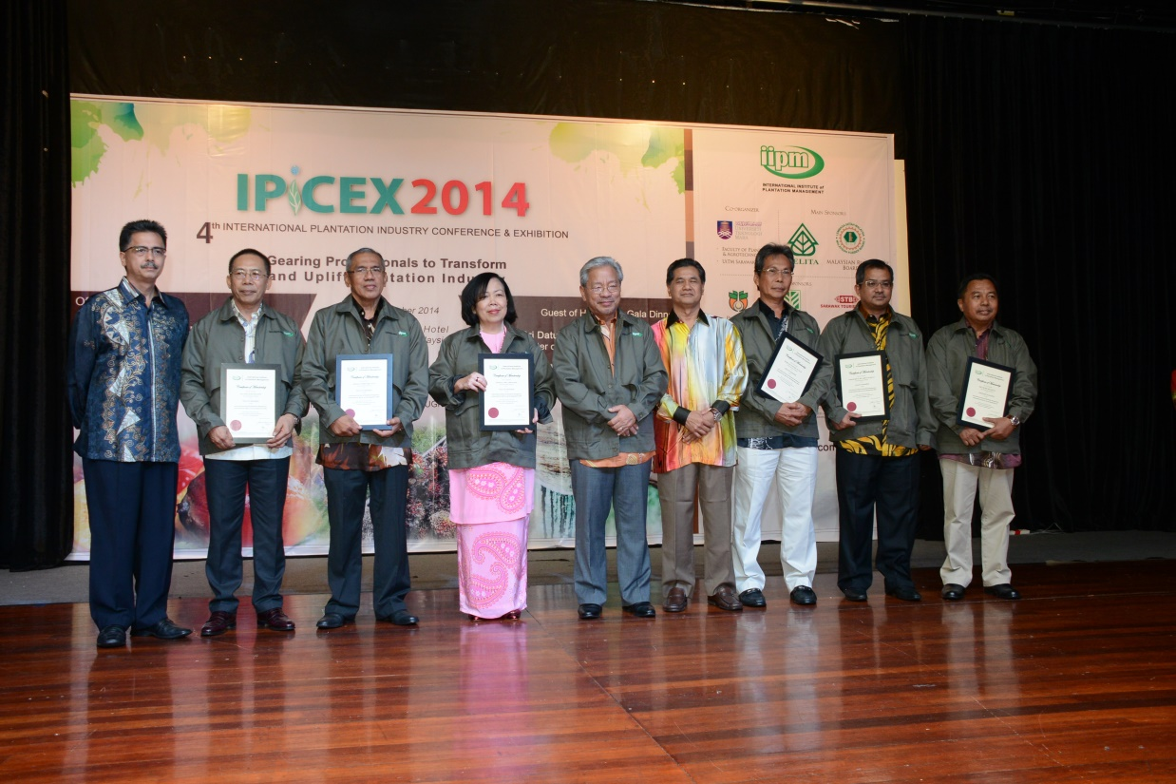
MOTTO OF IIPM
“Excellent Professional Plantation
Management Programs at Your Doorstep”
BRIDGING THE WORLD THROUGH PLANTATION
A Professional Body offshoot of

Slide 11
CONTRIBUTION TO HUMAN CAPITAL DEVELOPMENT AND NATION BUILDING
Professional Education Programs
(Plantation Management)
Professional Qualifying Examination in Plantation Industry Management
Professional Diploma in Plantation Management
Certificate in Plantation Industry Management
Certificate in Forest Plantation Management
Professional Diploma in Palm Oil Mill Technology and Management
Certificate in Palm Oil Mill Management
(the above programs are in early development stage)
Professional Education Programs
(Palm Oil Mill Management)
Professional Diploma in Occupational Safety and Health Management
Certificate in Occupational Safety and Health Management
(the above programs are in early development stage)
Professional Education Programs
(Occupational Safety and Health Management)
MQA 10/4 Jld. 11(86)
Equivalent level 6: Bachelor Degree
MQA/NT0187
MQA/NT0188
Professional Qualifying Examination (PQE)
in Plantation Industry Management
Certificate in Plantation Industry Management (CPIM)
(equivalent to level 3
(Department of Skill Development))
Level 3: E 16755
(equivalent to Level 6 (Bachelor Degree))
Certificate of Accreditation Training Centre NDTS (PD5692)
BRIDGING THE WORLD THROUGH PLANTATION
A Professional Body offshoot of

Slide 12
IIPM TRAINING PROGRAMME
Skills Development Program
Sijil Penyeliaan dan Operasi Ladang
Kursus Pekerja Mahir Ladang
Pembangunan Minda Insan
Kecemerlangan Pendidikan
Continuous Professional Development Program
Conference
Seminar/Tea Talk
Kursus Usahawan Tani Fertigasi
Kursus Pengurusan Tapak Semaian: Kelapa Sawit dan Getah
Kursus Landskap Ameniti
Kursus Usahawan Ladang
Certified Planter (CP)
Research & Development
Consultancy
Specialist Professional Qualification
Sijil Penyeliaan & Operasi Ladang (SPOL)
(equivalent to level 3
(Department of Skill Development))
Level 3: E 16755
Certificate of Accreditation Training Centre NDTS (PD5692)
BRIDGING THE WORLD THROUGH PLANTATION
A Professional Body offshoot of

Slide 13
ACADEMIC SKILLS AND PROFESSIONAL PATHWAY
ACADEMIC PATHWAY
(HIGHER LEARNING INSTITUTION)
Skill Sector (Ministry of Human Resources)
PROFESSIONAL PATHWAY
(IIPM)
MQF Level
Level 7 & 8
Post Graduate Program (Master / PhD)
Specialist Professional Qualification
Level 6
Bachelor
Degree
+ 3 years experience
Professional Qualifying Examination (PQE)
- Bachelor Degree
Skills Advanced Diploma
MQA 10/4 Jld. 11(86)
Equivalent level 6: Bachelor Degree
Level 5
Supervisor + 10 years experience
+ 2 years experience
Level 4
Diploma
Skills Diploma
Professional Diploma
MQA/NT0187
+ 8 years experience
Supervisor + 5 years experience
+ 3 years experience
3 Credits
Level 3
MQA/NT0188
Matriculation/
Foundation
5 Credits
Skills Certificate
Pass
Certificate
(CPIM / CFPM)
Level 1 & 2
SPM / MCE
+ 5 years experience
Level 3: E 16755
Equivalent to level 3: Department of Skill Development
Job Sector
Age ≥ 17 years
Malaysian Qualification Framework
SRP /PMR
Certificate of Accreditation Training Centre NDTS (PD5692)

Slide 14
OCCUPATIONAL SAFETY AND HEALTH
“Industry depends on skill and passion of our workers, so these issues are top priority” Randgold Resources
BRIDGING THE WORLD THROUGH PLANTATION
A Professional Body offshoot of

Slide 15
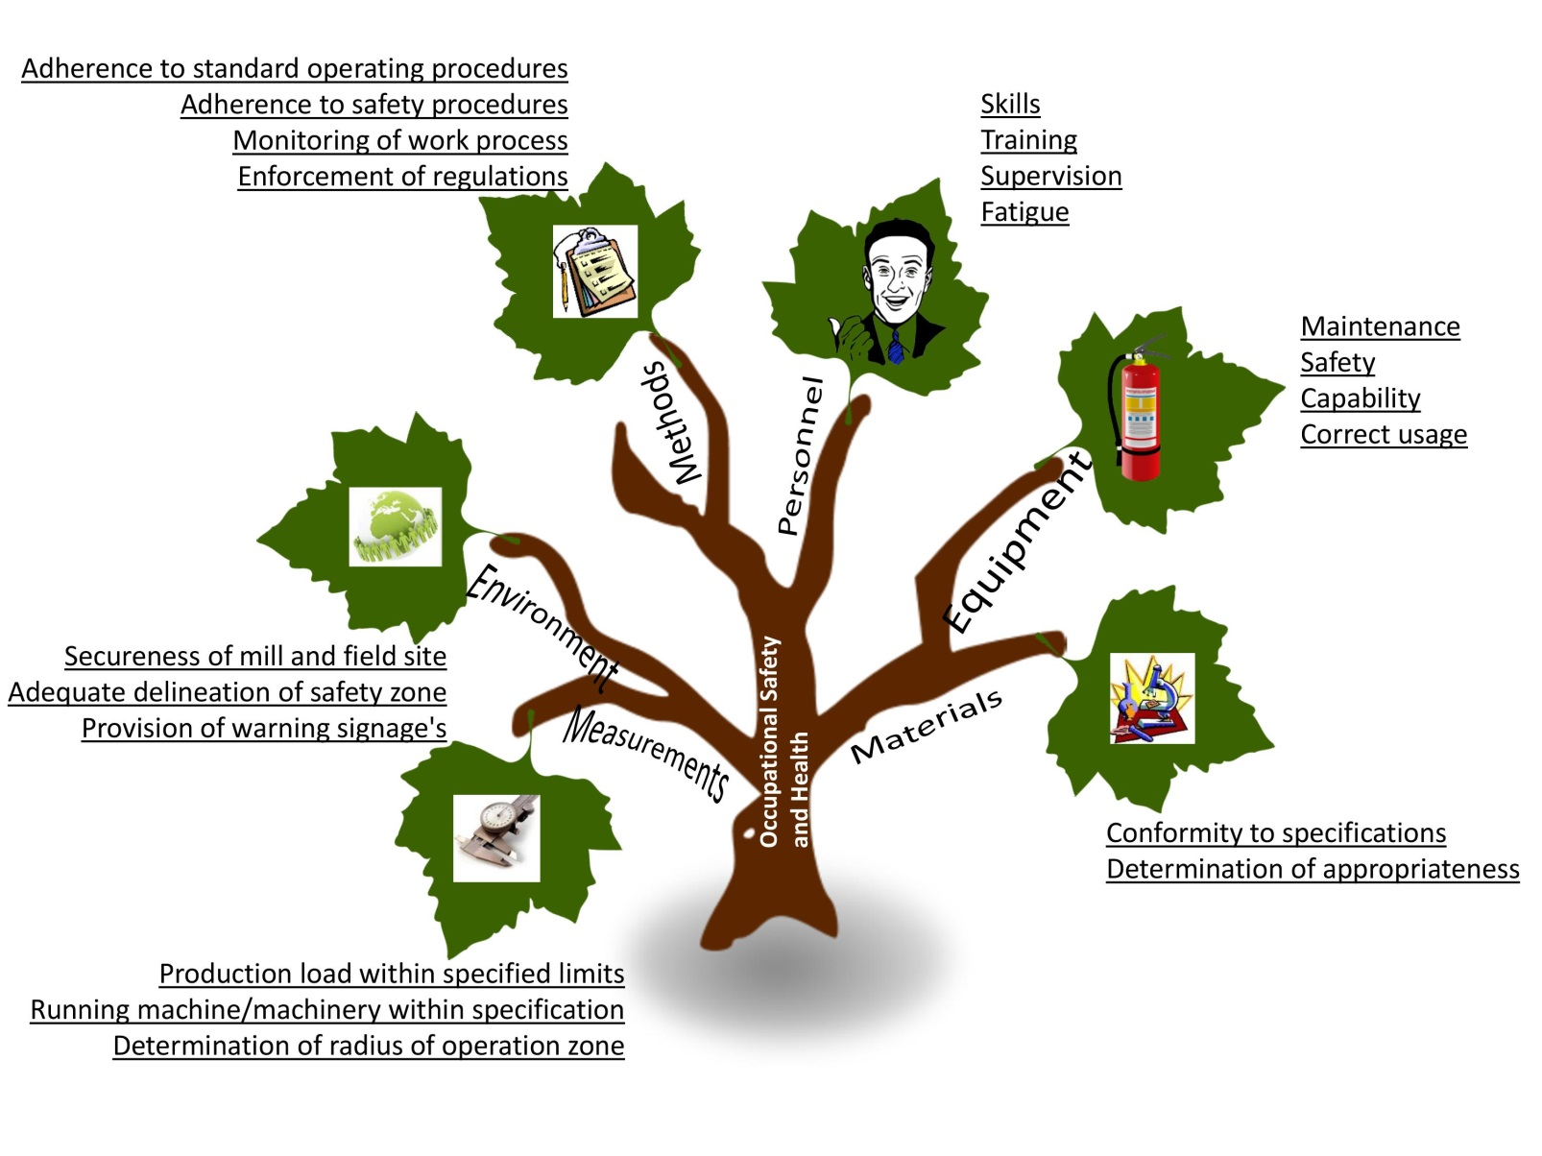
ACCIDENTAL CAUSES IN THE WORKPLACE
BRIDGING THE WORLD THROUGH PLANTATION
A Professional Body offshoot of

Slide 16
EMPOWERMENT OF TALENT IN THE OSHA WITH IIPM
PROFESSIONAL EDUCATION PROGRAM
Certificate in Occupational Safety And Health Management
Professional Diploma in Occupational Safety And Health Management
BRIDGING THE WORLD THROUGH PLANTATION
A Professional Body offshoot of

Slide 17
EMPOWERMENT OF TALENT IN THE OSHA WITH IIPM
Professional Diploma in Occupational Safety and Health Management
MQA Level 4 with 19 modules (90 credit hours)
Consists of 6 occupational safety and health modules, 10 foundation management modules, research, practical training and internship.
Safety and Health Officer from NIOSH
BRIDGING THE WORLD THROUGH PLANTATION
A Professional Body offshoot of

Slide 18
EMPOWERMENT OF TALENT IN THE OSHA WITH IIPM
Certificate in Occupational Safety And Health Management
MQA Level 3 with 12 modules (60 credit hours)
Consists of 4 occupational safety and health modules, 5 foundation management modules, research, practical training and internship.
Plantation Safety Supervisor Certificate from NIOSH.
BRIDGING THE WORLD THROUGH PLANTATION
A Professional Body offshoot of

Slide 19
EMPOWERMENT OF TALENT IN THE OSHA WITH IIPM
CONTINUOUS PROFESSIONAL DEVELOPMENT PROGRAM
Occupational Safety and Health in the Office
High Impact OSH Presentation Skills
Undestanding, Evaluation and Implementing Effective HIRARC at workplace
OSH and Environmetal Management Programme
Safety and Health Officer Enrichment Program
Back Protection Programme
Ergonomics and Manual Handling in the Workplace
Efective Safety and Health Committee
Compliance to Factories and Machinery Act 1967 and Its Regulations
Compliance to Regulations Under OSHA 1994
Occupational Safety and Health Act 1994
Train the Trainer
Training Management for Business
BRIDGING THE WORLD THROUGH PLANTATION
A Professional Body offshoot of

Slide 20
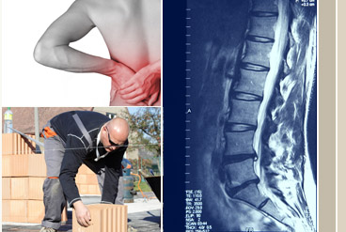
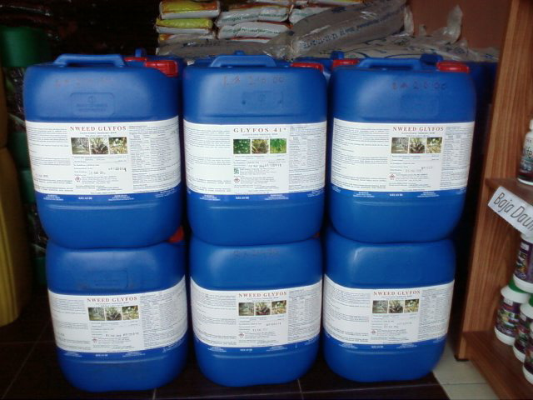
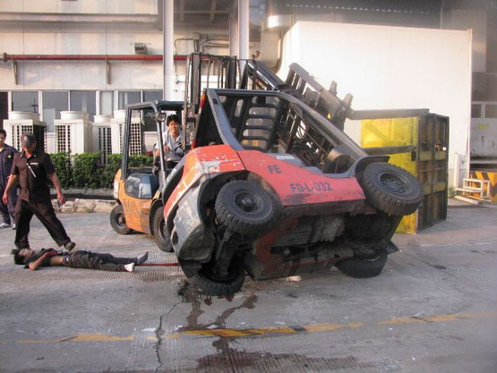
WORKPLACE INJURIES & ACCIDENTS
BRIDGING THE WORLD THROUGH PLANTATION
A Professional Body offshoot of

Slide 21
ACHIEVEMENT RECORD – TRAINING STATISTICS
Company | Professional Education |  |  |  | Continuous Development Programs |  |  | TOTAL
 | PQE | PDPM | CPIM | CFPM | SDP | ADP | Conferences & Talks
Government agencies |  | 64 (Felda & MARDI) | 136 (Felcra , KYS & MARDI) |  | 75 (KKLW) | 141 (KKLW) | 780 (UiTM,, MARDI, MRB & LKTN) | 1,196
GLCs & Agencies |  |  | 581 (FGVHB & SSB) | 17 (SSB) | 157 (PPPNP) |  | 50 (SSB & PPNJ) | 805
NGOs |  |  |  |  | 17 (AIM) | 75 (AIM) |  | 92
Industries | 46 |  | 13 |  | 25 (FTC) | 43 (FTC) | 1,808 | 1,935
Total | 46 | 64 | 730 | 17 | 274 | 259 | 2,638 | 4,028
BRIDGING THE WORLD THROUGH PLANTATION
A Professional Body offshoot of

Slide 22
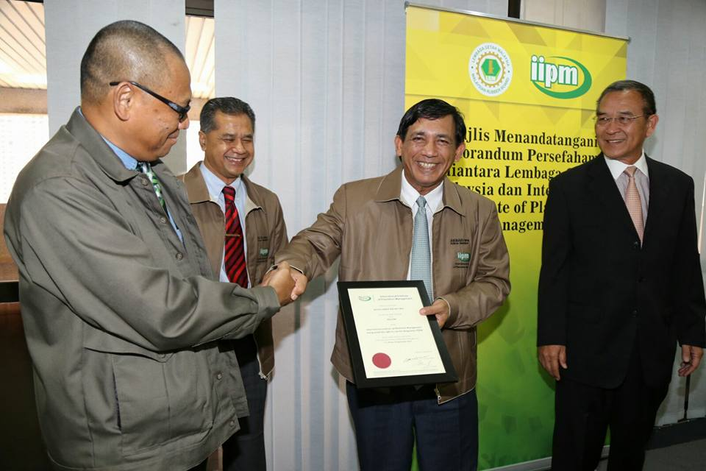
PROFESSIONAL MEMBERSHIP
Academic, Career And Membership Pathway
Motto
Director
Chief Executive Officer
Planting Advisor
PQE
General Manager
Senior Manager
Cadet Planter
Manager
Master holder
PQE Student
Professional Diploma
Assistant Manager
Bachelor Degree
IIPM Lecturer
Supervisor
Cadet Planter
Professional Certificate
Student Member
Affiliate Member
Associate Member
Ordinary Member
Certified Planter
Fellow IIPM
Knowledge
Skills
Attitude
Networking
BRIDGING THE WORLD THROUGH PLANTATION
A Professional Body offshoot of

Slide 23
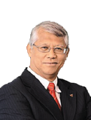
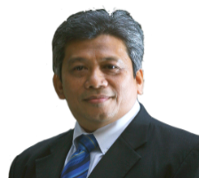
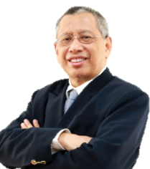
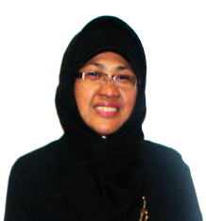
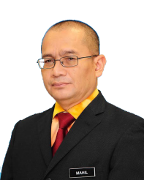
IIPM BOARD OF COUNCIL
President IIPM/ VC UiTM
Professor Emeritus Dato’ Dr. Hassan Said
Deputy President
Datuk Haji Daud Amatzin FiiPM
Executive Director
Halid Hasbullah Boestamam FiiPM
1 2 3 4 5 6 7 8 9 10
IIPM Board of Council Members
1. Ahmad Fer-Rouse FiiPM, 2. Haji Md Yid Md Sofian FCP, 3. Datuk Dr. Sharif Haron FiiPM, 4. Datuk Dr. Mohd Akbar Md Said FiiPM, 5. Dr. Razali Abd. Malik FiiPM, 6. Dr. Haji Ahmad Khusairi Din FiiPM, 7. Dato’ Dr. Mohd Padzil Hashim, 8. Assoc. Prof. Dr. Fauziah Haji Ismail FiiPM ,
9. Dato’ Dr. Mohamad Hashim Ahmad Tajuddin dan 10. Mohamad Mahil Ahmad
BRIDGING THE WORLD THROUGH PLANTATION
A Professional Body offshoot of

Slide 24
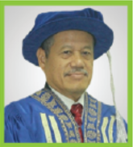
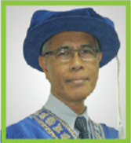
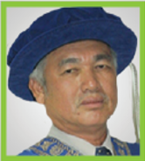
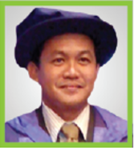
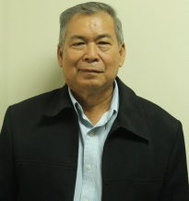
PROFESSIONAL AND ACADEMIC ADVISORY BOARD
PROFESSIONAL AND ACADEMIC ADVISORY BOARD
Datuk Dr. Rosti Saruwono (Chairman)
Ph.D. Brunel University, UK (1990-1993)
MBA Brunel University, UK (1983-1984)
B.E (Mech) University of Queensland (1970-1973)
Malay College Kuala Kangsar (1963-1969)
Dr. Razali Abd. Kader
(Member)
Ph.D. (Wood Science)
University of Wales,
UK (1985)
M.S (Wood & Fibre Utilization) University of Washington, USA (1976)
B.S. (Forest Products) Oregon State University, USA (1974)
Diploma in Forestry Institut Teknologi MARA (1972)
Dr. Md. Aris Ahmad
(Member)
Ph.D. (London School of Polymer Technology, North London University, U.K., 1990)
MSc. In Polymer Science and Technology, North London University, U.K., (1986)
Grad PRI, North London University, U.K., (1984)
HND in Polymer Science and Technology, UK, (1982)
Asoc. Prof. Dr. Mohd Rasdi Zaini (Member)
Ph.D. in Agriculture Entomology, Universiti Sains Malaysia (2010)
M.Sc in Agriculture Entomology, Universiti Teknology MARA (2005) B.SC in Plantation Technology & Management, Universiti Teknologi MARA (2002)
Diploma in Planting Industry Management, Institut Teknologi MARA (1996)
Prof. Dr. Khalifah Othman (Member)
Ph.D. (Marketing/Retailing, University of Stirling, U.K, 1987)
MBA, Northern Illinois University, U.S.A., (1972)
B.Sc (Finance), Northern Illinois University, U.S.A.., (1971)
Diploma in Business Studies, Institut Teknologi MARA (1968)
BRIDGING THE WORLD THROUGH PLANTATION
A Professional Body offshoot of

Slide 25
WHO ARE OUR PARTNERS?
FELDA
FGVPM Sdn Bhd
FELCRA Berhad
Kolej FELCRA
Sabah Softwood Berhad
Kolej Yayasan Sabah
Benta Wawasan Sdn Bhd
PPPNP
UiTM
UMS
UPM
UMK
UMT
UNIMAS
Sarawak Plantation Berhad
Sawit Kinabalu Sdn Bhd
MPOB
LGM
MARDI
MTIB
MPIB
Akademi Hevea Malaysia
Perbadanan KemajuanPertanian Negeri Pahang (PKPP)
FELDA Berhad
FGVPM Sdn Bhd
FELCRA Berhad
Kolej FELCRA
Sabah Softwood Berhad
Kolej Yayasan Sabah
Benta Wawasan Sdn Bhd
PPPNP
UiTM
UMS
UPM
UMK
UNIMAS
Sarawak Plantation Berhad
Sawit Kinabalu Sdn Bhd
MPOB
LGM
MARDI
MTIB
MPIB
Akademi Hevea Malaysia
BRIDGING THE WORLD THROUGH PLANTATION
A Professional Body offshoot of
BRIDGING THE WORLD THROUGH PLANTATION

Slide 26
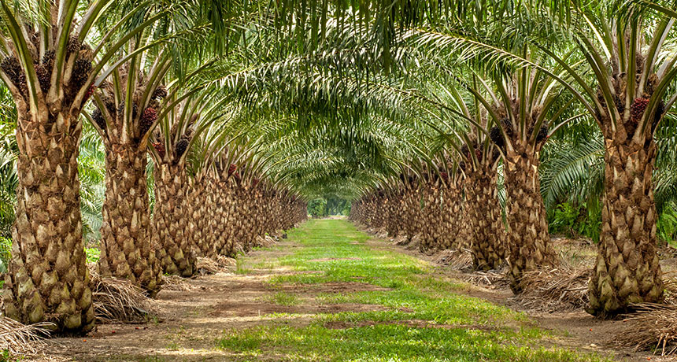
BRIDGING THE WORLD THROUGH PLANTATION
A Professional Body offshoot of

